Slide 1
Modular Java with OSGI
Todd Kaufman

Slide 2
Questions
Who is this guy?
Why are we here?
What is Modularity?
WTF is OSGi?
HTF do I use OSGi?
All others?

Slide 3


Who is this guy?
Notes:
Java Architect for 10+ years
Quick Solutions Consultant for 6 years
App Dev Manager for way too long
OSGi -> Spring Experience and thought, meh. Then I continued to see usage scenarios as I went.
Homebrewer
Beer from mellowfood on flickr

Slide 4
Why are we here?
“Software development has advanced in large part by increasing the granularity of the aggregations that we have to work with.”
Steve McConnell from Code Complete
"... a fundamental enabling technology for 21st century enterprise computing”
Psychics at the Gartner Group
Notes:
OSGi is focused on aggregating components
Java up until now has been focused at the OO granularity (classes / interfaces)
Gartner prophets say it will be!

Slide 5
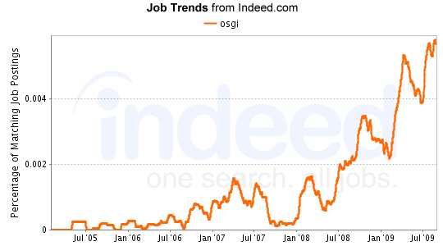
OSGi is Relevant
Notes:
Well except for the numbers on the left
Twitter traffic shows it too
Presentations, books, etc…

Slide 6
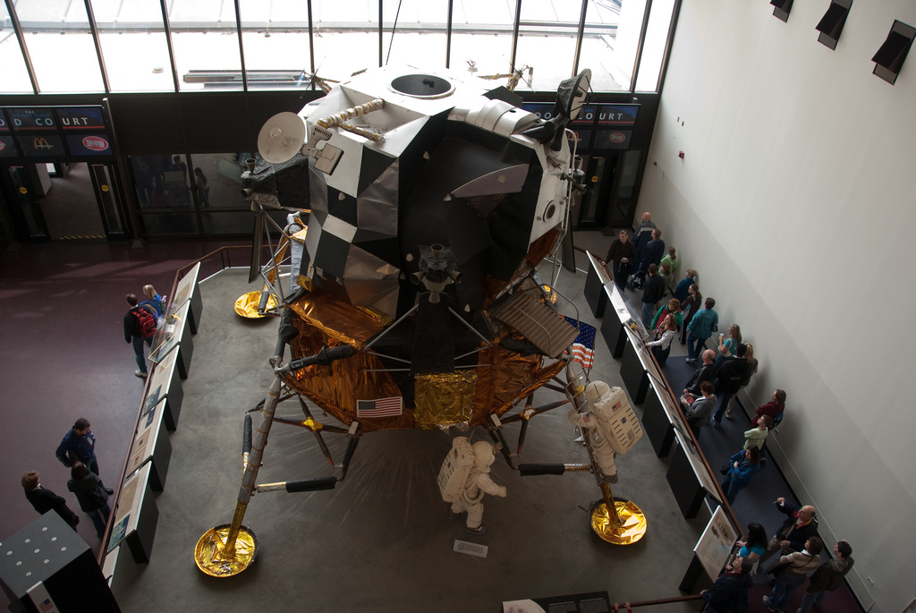
What is Modularity?
Notes:
Self contained components
Comprising a larger functional whole
Easier to conceptualize (test, maintain, etc…)
This is not new
- lunar module needed for moon landing and returning to lunar orbit, but even that was separated into ascent/descent stages
- don’t sell your car when your alternator dies

Slide 7

Cohesion = Good
Notes:
Do one thing and one thing well
Flip – good example
Piano chair – bad example

Slide 8

Coupling = Bad
Notes:
Integration with other modules done through stable, well defined interfaces
Legos -> Good example
HDMI -> Bad example (unstable)

Slide 9
Leads To
Flexibility
Testability
Comprehensibility
Parallelility?
Notes:
Flexibility – change underlying implementations without affecting consumers
Testability – easy to test the right thing when a component is solely focused on one thing
Comprehensibility – I can step in and get a feel for what is going on, even just on bundle names.
Parallelility – Teams working in parallel on small chunks can more efficiently build systems

Slide 10
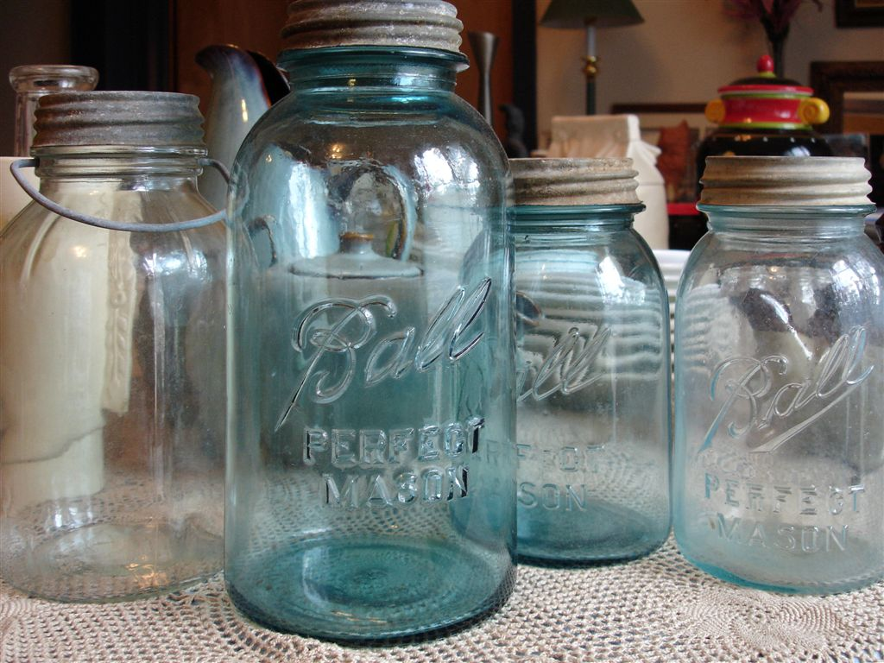
I do this in Java ALREADY!
Notes:
JARS! - Except they all wind up in the same classloader
OO Does it?
Layered design
Spring use to facilitate
Single deployment?
Multiple deployments wired together in a complex manner?

Slide 11
Problem #1 – Version Hell
Notes:
How do you declare dependencies in Java?
WEB-INF/lib?
What if?
You rely on A and Spring 2.5
A relies on Spring 1.2
Classloader tricks are the solution?!?!?

Slide 12
#2 – Critical Component
Notes:
Ever have one component that is used by everything?
Ever upgrade it?
Regression test hell!
Sat in a 20 person planning meeting for one such component
Would be nice to do a staggered upgrade…

Slide 13
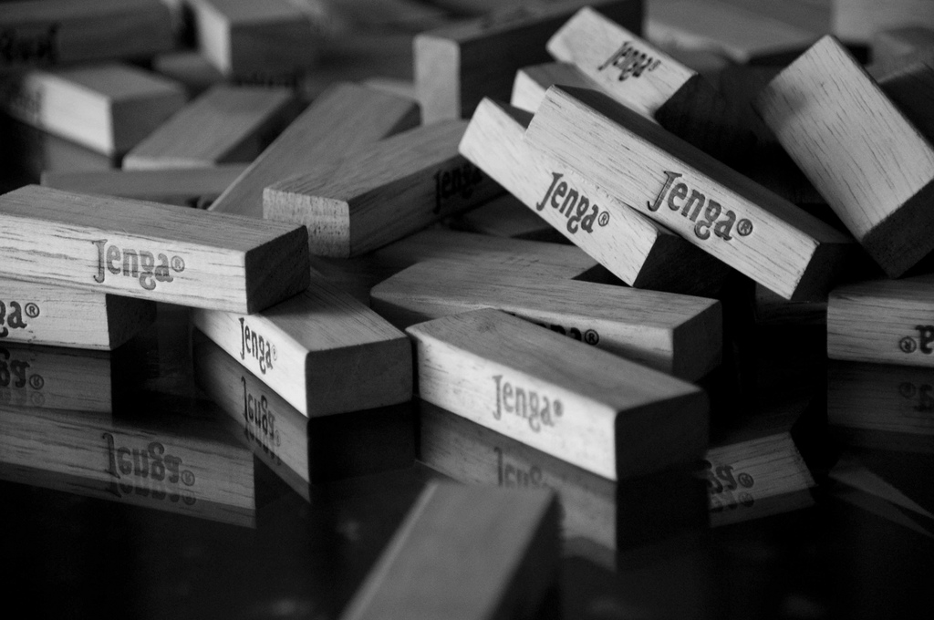
# 3 – OMG it’s finally working component
Notes:
The jenga component finally is working
Right mix of 42 dependencies has this thing kickin!
Don’t ever touch it again while still upgrading all other components

Slide 14
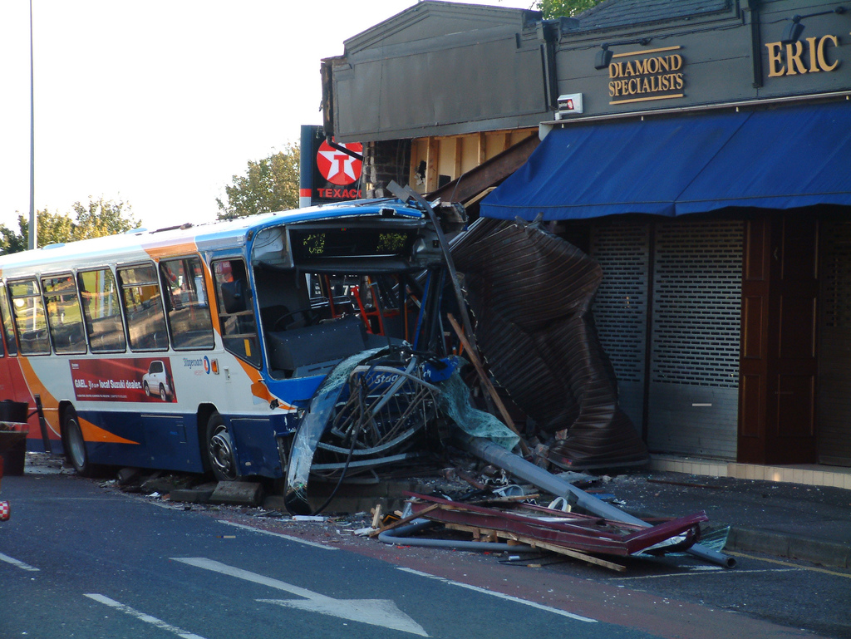
#4 – SOA with ESB and a FTL
Notes:
Separate all components into their own deployments
Connect with SOA
Live, breath, and love the <
ceremony />

Slide 15
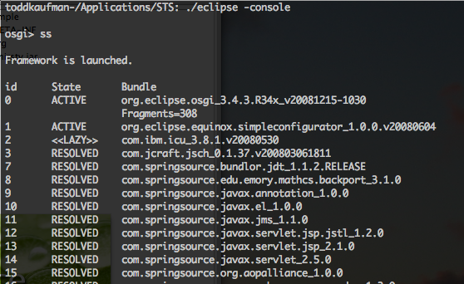
WTF is OSGi?
Notes:
Open Services Gateway Initiative
10 year old idea
JSR-8 (1999)
Eclipse adoption in 2003
Spring adoption in 2007?

Slide 16
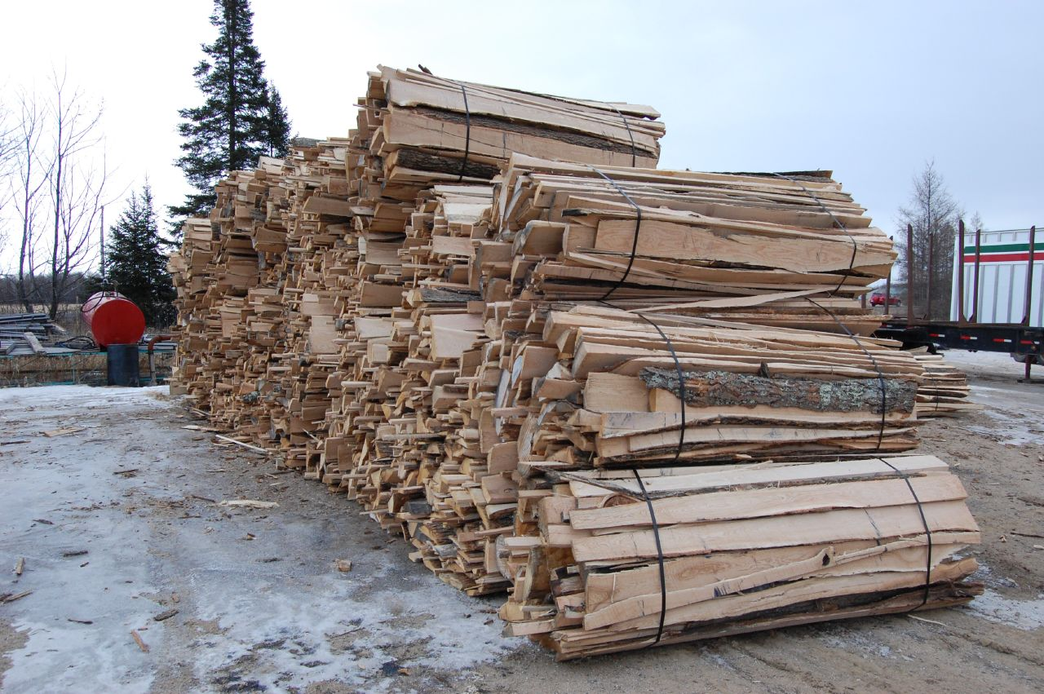
Bundles
Notes:
Jar files with a special MANIFEST.MF
Header
Activator

Slide 17




OSGi Containers
Notes:
Eclipse Equinox -> Most advanced, trying to meet all aspects of OSGI
Felix -> Close runner up, doesn’t have fragments yet
Knoplerfish -> Another close runner up
Concierge -> Small footprint (80k) targetting mobile devices

Slide 18
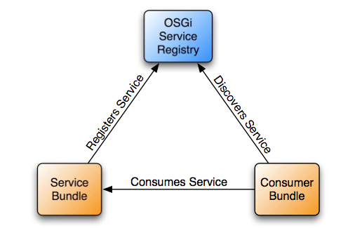
SOA in a JVM
Notes:
Service
Consumer
Registry
You provide the orange, OSGi container provides the blue

Slide 19
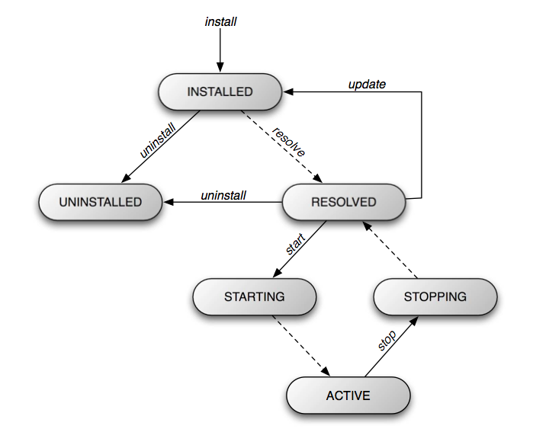
Lifecycle
Notes:
- Installed when it’s installed
If all dependencies are available at install time, will moved to resolved
Issue a start command to go from resolved to started (happens automatically at startup)
- Starting – Temporary state
- Active – ready for business
- Stopping – temporary state
If removed from the installed or resolved state, will be uninstalled and no longer visible

Slide 20

HTF do I use OSGi?

Slide 21
Lessons Learned - Simple
Bundles = Jar files with a specific manifest.mf
Understand the states
Minimally invasive APIs
Manual process sucks

Slide 22
Lessons Learned - Pax
Pax-construct helps!
What about the services?

Slide 23
Lessons Learned - Services
Still just interfaces
Pax helps
Complex
Invasive
Need a strategy for dealing with missing services
Java is the COBOL of 2010

Slide 24
Lessons Learned - Groovy
OSGi just feels like a JVM
Groovy necessitates Classloader tricks
Scala available, Jruby coming…
OSGi seems invasive
How does DI fit in?

Slide 25
Lessons Learned – Spring DM
Much Better
Complexity Down
Non-invasive
OSGi feels just like a runtime now
Issues are hard to find
Would be nice to enable logging in the spring extender bundle

Slide 26
Lessons Learned - Fragments
Open Closed Principle applies to Bundles
Useful for skinning, translation, tweaking behavior
Open for EXTENSION, closed for modification
Felix does not yet support
Notes:
pax-create-bundle -p org.cojug.modular.microbrewery.spring-log -n spring-log -g org.cojug.modular.microbrewery -v 1.0.0-SNAPSHOT -- -Dinterface=false –Dinternals=false

Slide 27

Tips and Tricks

Slide 28
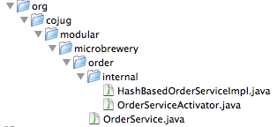
Keep Interfaces Separate
Notes:
When exporting the interface package you don’t export subpackages
Internals are private

Slide 29
How to Bundle?
Horizontal & Vertical bundling
Look at sub system verticals
Look at horizontals within each
Separate Domain bundle across

Slide 30
Leverage the Tools
Pax Construct for rapid development cycles
Pax Runner for execution environment
SpringDM for a less invasive OSGi
SpringSource Enterprise Bundle Repository
Bundlor for bundles that aren’t

Slide 31
Bundle or Embed?
Sometimes Bundles don’t export anything
Can either wrap them in a MANIFEST with necessary exports
Can also embed the jar
Check out Bundlor

Slide 32
Enable Logging
Debug by logging is pretty useful
SpringDM and other bundles can have logging enabled by fragment extension
OSGi has it’s own logging subsystem

Slide 33
What else?
Web apps
Testing
Configuration
Production
OSGi Blueprint
Stay tuned…

Slide 34
Resources
Modular Java by Craig Walls
OSGI Spec
SpringDM
OPS4J
Helpful Blogs
TurmoilDrivenDevelopment
Craig Walls’ Blog
If I ever stop being lazy, then mine

Slide 35
Pics
Beer courtesy of mellowfood on flickr
Relevance graph from indeed.com
Lunar Module courtesy of Jonathan Caves on flickr
Flip courtesy of dots and spaces on flickr
Hdmi courtesy of kprogram on flickr
Jars courtesy of Patrick Q on flickr
Jenga courtesy of ★ Zerjio ★ on flickr
Bus crash courtesy of PhylB on flickr
Bundles courtesy of esagor on flickr
SOA in a JVM courtesy of Craig Walls - Modular Java
Lifecycle courtesy of Craig Walls - Modular Java
Sledgehammer courtesy of Matti Mattila on flickr
Tricks courtesy of bframe5 on flickr

Slide 36
Any other questions?
SpeakerRate Comments Appreciated
@toddkaufman
614-565-8132
toddkaufman@gmail.com

